Slide 1
Database Concepts
File Systems and Databases

Slide 2

Students Introduction

Slide 3

Take this course or NOT?
This course is for highly motivated students.
A complete practical course

Slide 4
What is difficulty level of this course
Difficultly level of this course is medium. Its not that easy not that hard

Slide 5
Projects and Assignments
Each module will have individual project with documentation
Every week there will be 1 or 2 assignments you have to submit on the time
You will get proper guide for everything you need to complete your project but you have to take all the lectures regularly and go through assignments.

Slide 6

Class attendance
Class attendance is very important and it contain marks.

Slide 7
Marks distribution
Module 1
Weekly Assignments 10%
  Quiz 5%
  Project 15% (Game Project, GDD(Game design document), Viva)
Practical 2
Weekly Assignments 10%
  Quiz 5%
  Project 25%
  Final Exam
  30% Written (theory, viva,practical, class participation)

Slide 8


Slide 9
Outline
What a database is, what it does, and why database design is important
How modern databases evolved from files and file systems
About flaws in file system data management
What a DBMS is, what it does, and how it fits into the database system
About types of database systems and database models

Slide 10
Data versus Information
Example:
Robcor company has two divisions and the two division has 1,380,456 and 1,453,907 invoices, respectively.
Each invoice has invoice number, date, and amount
The period is from the first quarter of 1997 to first quarter of 2002
Total 2,834,363 records

Slide 11
Data versus Information
… | … | …
3000124 | 12-Jan-2002 | $121.98
… | … | …
Data
Information:----------?

Slide 12
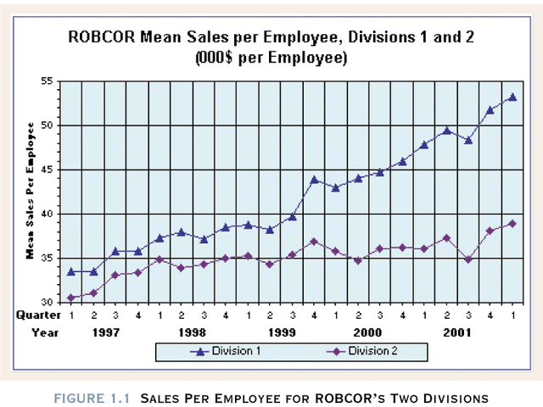

Slide 13
Data versus Information
Data constitute building blocks of information
Information produced by processing data
Information reveals meaning of data
Good, timely, relevant information key to decision making
Good decision making key to organizational survival

Slide 14
Database Management
Database is shared, integrated computer structure that stores a collection of data:
  End user data (raw data)
  Metadata (data about data, it contains data characteristics and relationships)

Slide 15
Database Management
Database Management System (DBMS): software system (collect of software) help to manage the data contents
  Manages Database structure
  Controls access to data
  Contains query language
Application software
DBMS
Database

Slide 16
Importance of DBMS
  Makes data management more efficient and effective
  Query language allows quick answers to ad hoc queries
  Provides better access to more and better-managed data
  Promotes integrated view of organization’s operations
  Reduces the probability of inconsistent data
  Improved data sharing
  Improved data security

Slide 17
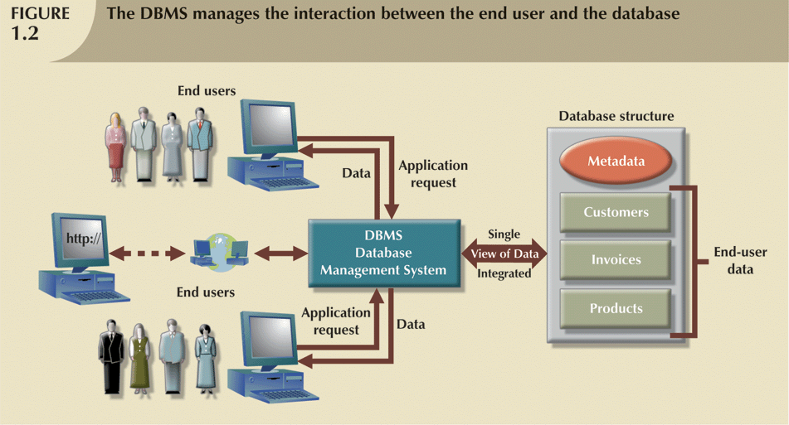


Slide 18
Why Database Design is Important
Database design focuses on design of database structure used for end-user data
  Designer must identify database’s expected use
Well-designed database:
  Facilitates data management
  Generates accurate and valuable information
Poorly designed database:
  Causes difficult-to-trace errors

Slide 19
Historical Roots of Database
Files and File Systems:
Why we need to study files and file system?
  Historically handling data
  Help to understand database design

Slide 20
Historical Roots of Database
Files and File Systems:
First applications focused on clerical tasks
Requests for information quickly followed
File systems developed to address needs
  Data organized according to expected use
  Data Processing (DP) specialists computerized manual file systems

Slide 21
File Terminology
Data
  Raw Facts
Field
  Group of characters with specific meaning
Record
  Logically connected fields that describe a person, place, or thing
File and file folder
  Collection of related records

Slide 22
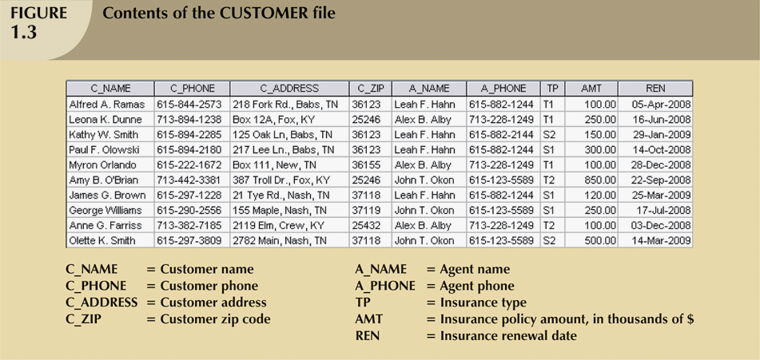

Slide 23
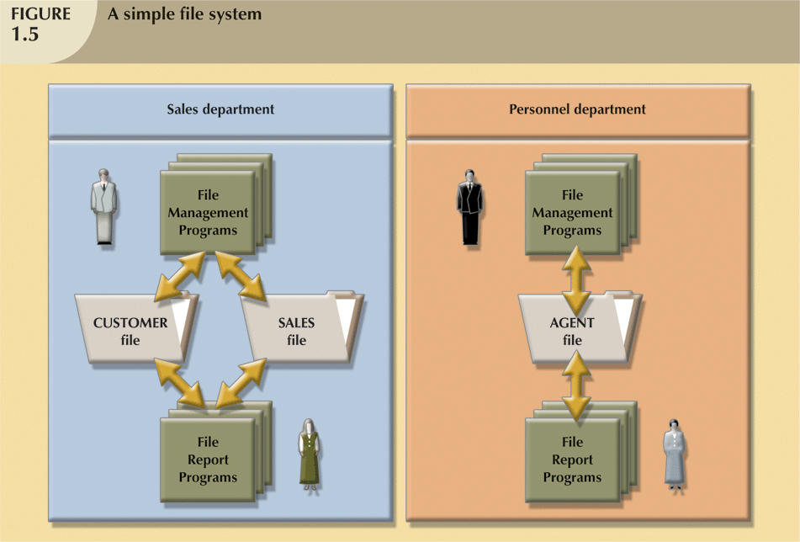

Slide 24
File System Critique
File System Data Management
  Requires extensive programming in third-generation language (3GL): COBOL, Basic, and Fortran (what must be done and how it is to be done)
  Time consuming
  depends on physically store data
  Makes ad hoc queries impossible
  Make difficult to modify file system (each file has its own system)
  Leads to islands of information

Slide 25
File System Critique (con’t.)
Data Dependence
  Change in file’s data characteristics requires modification of data access programs
  Must tell program what to do and how to do
  Makes file systems cumbersome from programming and data management views
Structural Dependence
  Change in file structure requires modification of related programs

Slide 26
File System Critique (con’t.)
Field Definitions and Naming Conventions
  Flexible record definition anticipates reporting requirements
  Selection of proper field names important
  Attention to length of field names
  Use of unique record identifiers

Slide 27
File System Critique (con’t.)
Data Redundancy: (Unnecessary Duplication of data)
  Results of uncontrolled data redundancy
    Data anomalies
      Modification
      Insertion
      Deletion
    Data inconsistency (Different and conflicting versions of same data)
      Lack of data integrity

Slide 28
Database Systems
Database consists of logically related data stored in a single repository
Provides advantages over file system management approach
  Eliminates data inconsistency (lack of data integrity), data anomalies, data dependency, and structural dependency problems
  Stores data structures, relationships, and access paths

Slide 29
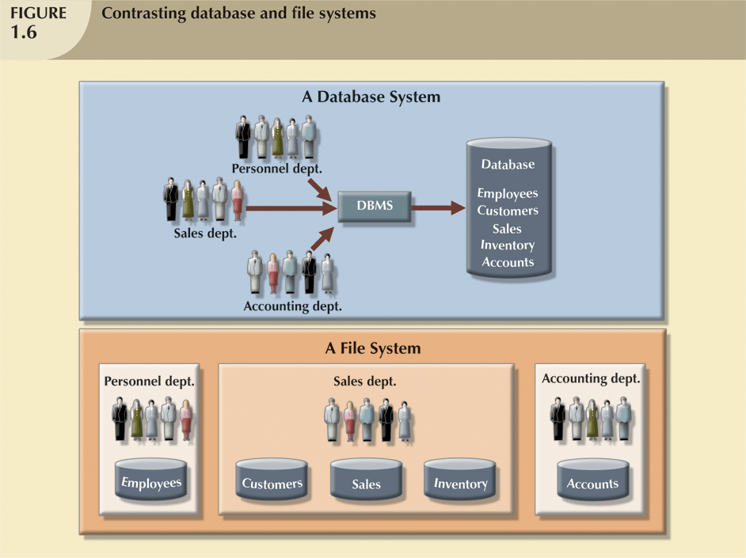
Database vs. File Systems

Slide 30
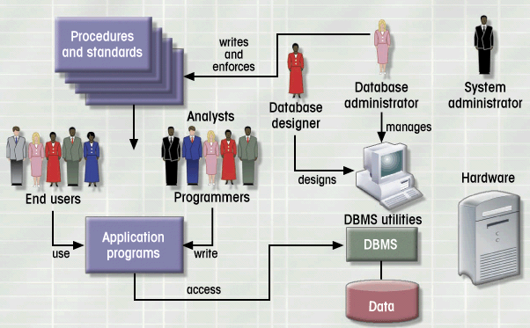
Database System Environment

Slide 31
Database System Environment
Hardware
  System’s Physical devices
    Computers
    Peripherals
    Network

Slide 32
Database System Environment
Software
  Operating system: manages hardware components
  DBMS: manages database
    MS Access, SQL Server, Oracle, DB2
  Application and utility software: support access and manipulate data
    Generate information for decision making
    Help to manage database system

Slide 33
Database System Environment
People (five users)
  System administrator: hardware system support
  Database administrator: manage DBMS use
  Database designer: design database structure
  System analyst and programmers: implement application programs
  End users

Slide 34
Database System Environment
Procedures
  Instruction and rule that govern the design and use of the database system
Data

Slide 35
Database System Types
Single-user vs. Multi-user Database (user number)
  Desktop database – Single user
  Workgroup database --supports a small number
  Enterprise database --supports a large number
Centralized vs. Distributed (location)
Use
  Production or transactional
  Decision support or data warehouse
  (obtain information)

Slide 36
DBMS Functions
Objective: Guarantee the integrity and consistency of data. It has several functions:
  Data dictionary management: (the definition of the data elements and their relationships are stored in a data dictionary). It remove data and structure dependencies.
  Data storage management: structures required for data storage
  Data transformation and presentation: relieving us from the distinct between logical data format and physical data format
  Security management
  Multiuser access control (concurrency)

